Slide 1
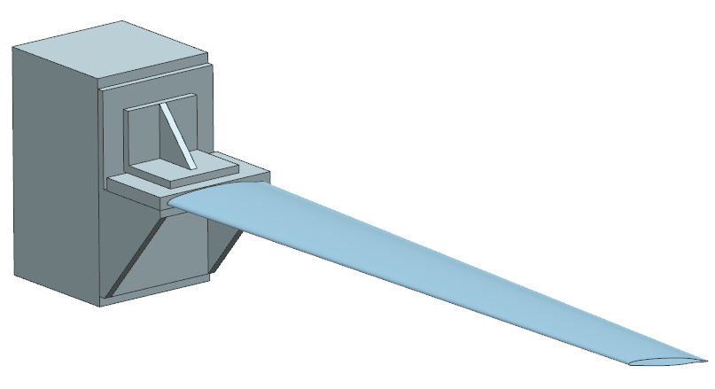
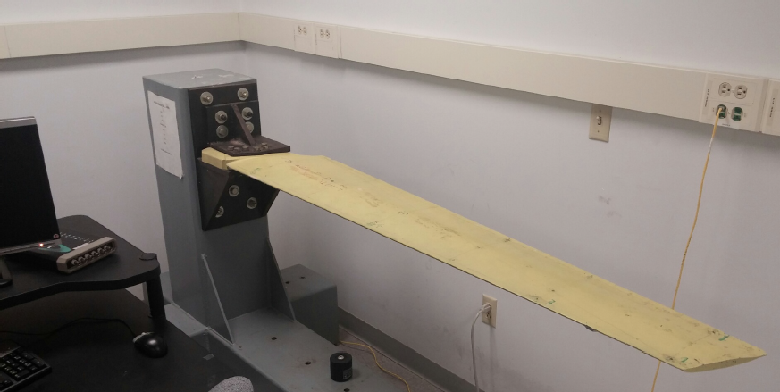
Modeling of Wing from Vibration Lab
Admir Makas

Slide 2
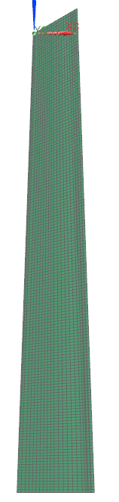
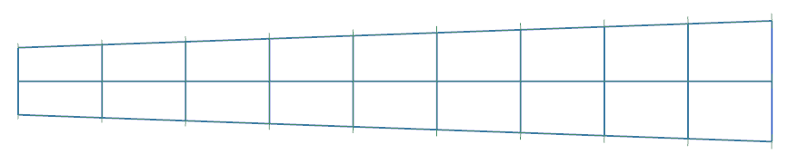
Overview
Reason behind reverse engineering the cantilever wing is to use the model for the Reliability class project. This will allow for comparison of simulations with experimental results from the vibration class.
Project will study impact of material and geometrical variations on modal response of the wing.
In following presentation two wing models were studied.
Wing was modeled using hand measurements. This is considered lowest fidelity method to obtain wing geometry but yielded very good results.
BEAM MODEL
SHELL MODEL

Slide 3
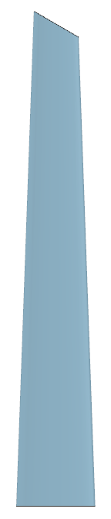
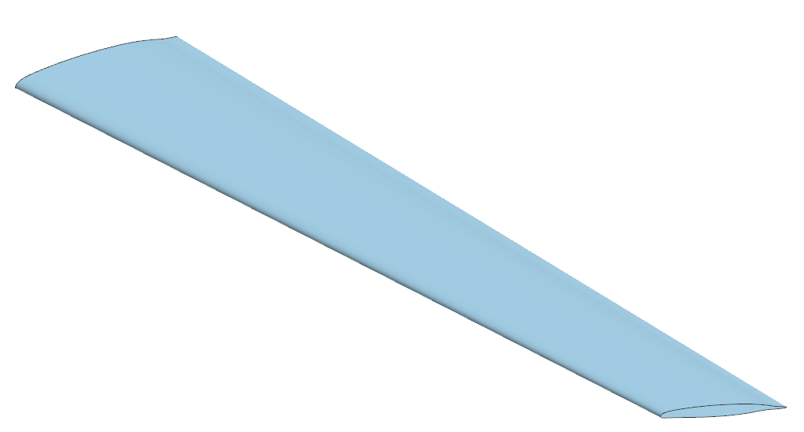
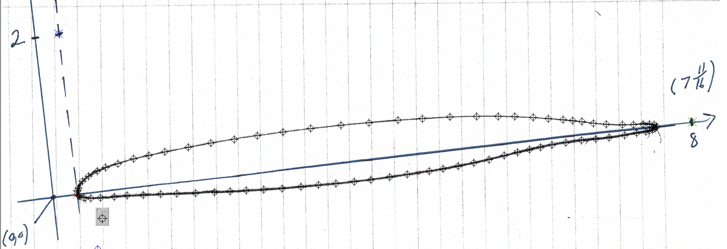
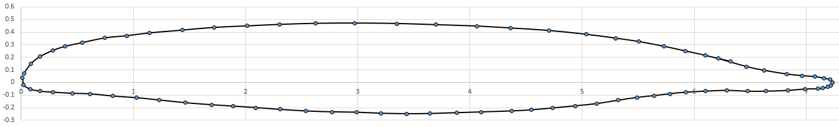
Modeling Technique
159 MM
18.5 MM
Overall dimension of the wing such as length, width, and thickness were obtained using ruler and tape measurer.
Airfoil profile was obtained by scribing the edge on paper. Subsequently, profile coordinates were obtained using a picture editor with respect to the chord line.
Mass = 12.91 Kg
1778 MM
Thickness = 6 MM
286 MM
30 MM

Slide 4
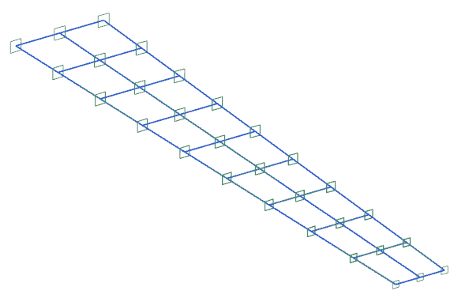
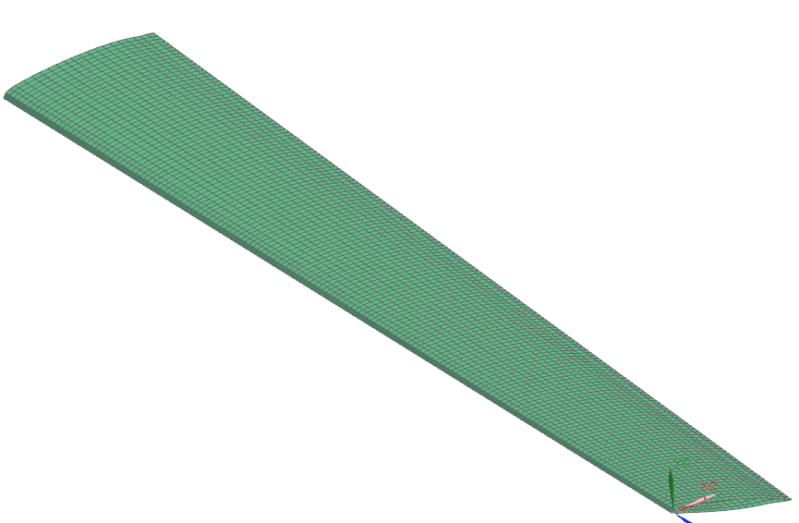
FEA Models
CAD model was used to aid in FEA model creation for frequency analysis.
Two model types were studied: Beam Wing Model and Shell Wing Model
BEAM MODEL
SHELL MODEL
FIXED END
FIXED END
Solution type: SOL 103
Element Type:
CBEAM (27 elements)
BAR (18 elements)
Model Mass = 12.8 Kg
Solution type: SOL 103
Element Type:
CQUAD (660)
Model Mass = 12.84 Kg

Slide 5
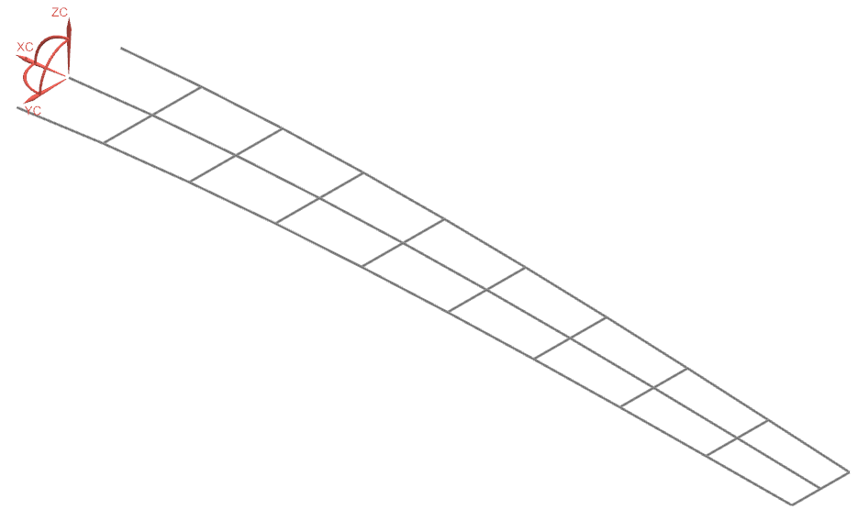
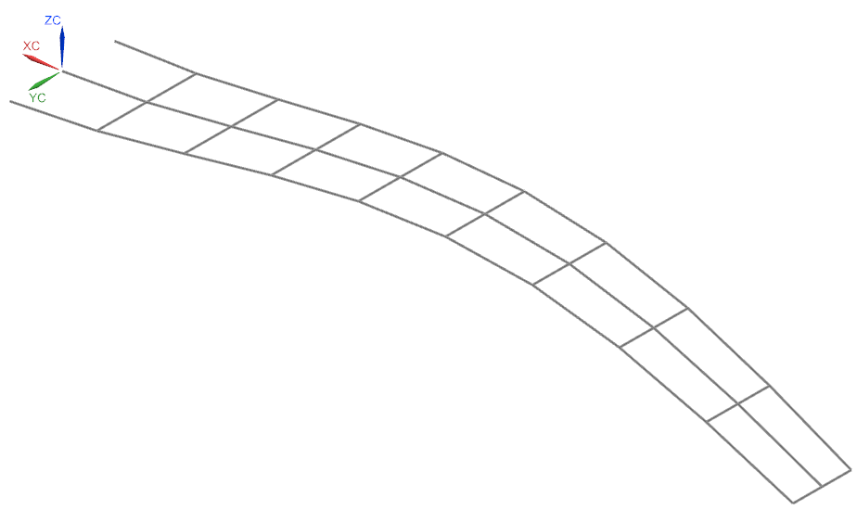
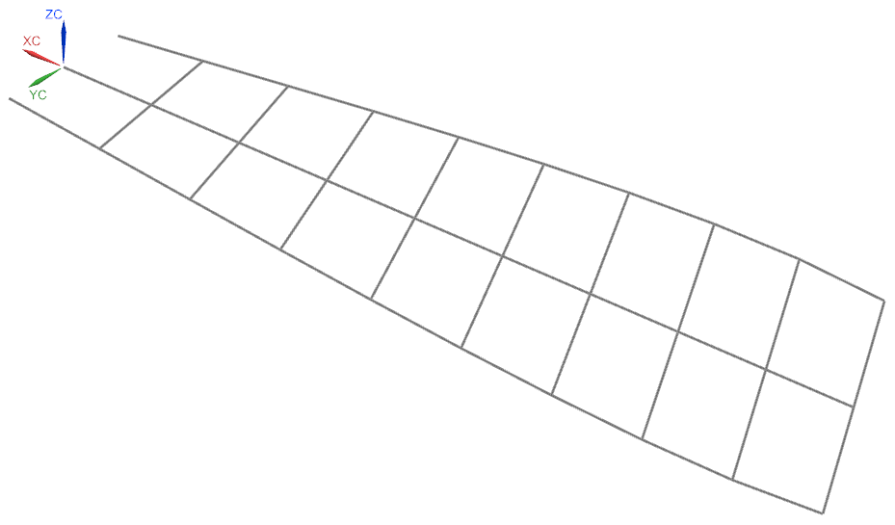
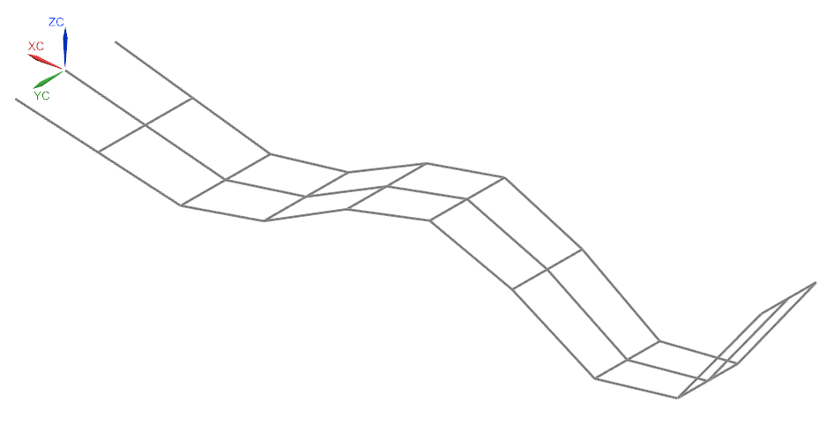
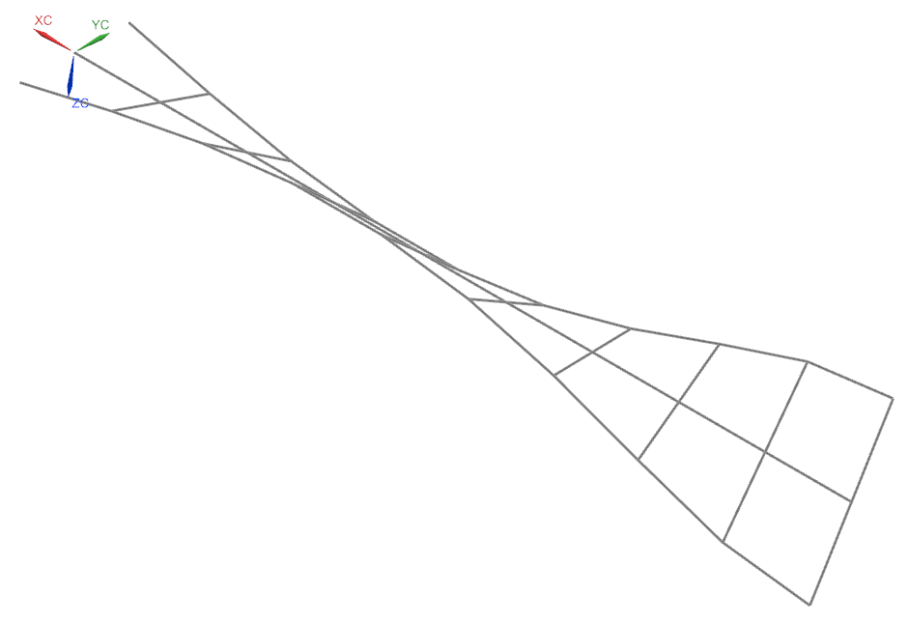
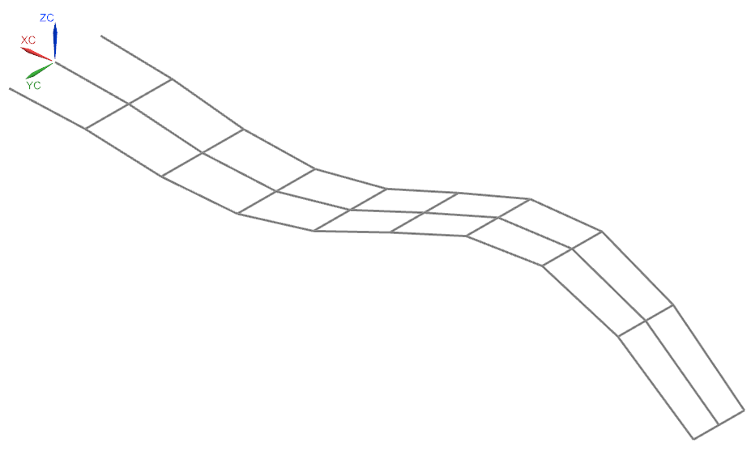
FEA Results (BEAM)
Mode 1
Mode 2
Mode 4
Mode 5
Mode 6
Mode 3

Slide 6
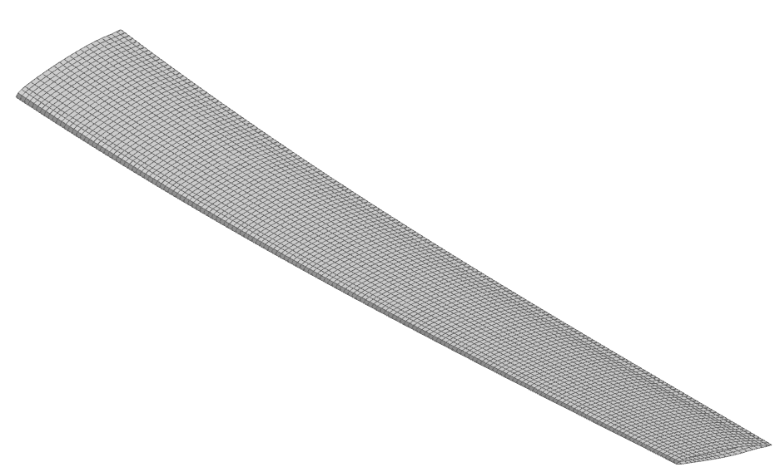
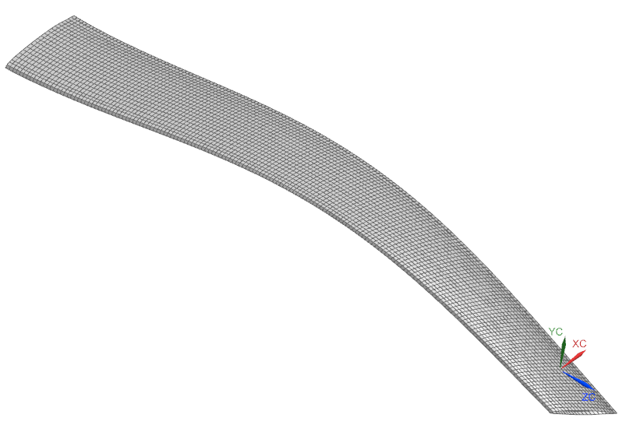
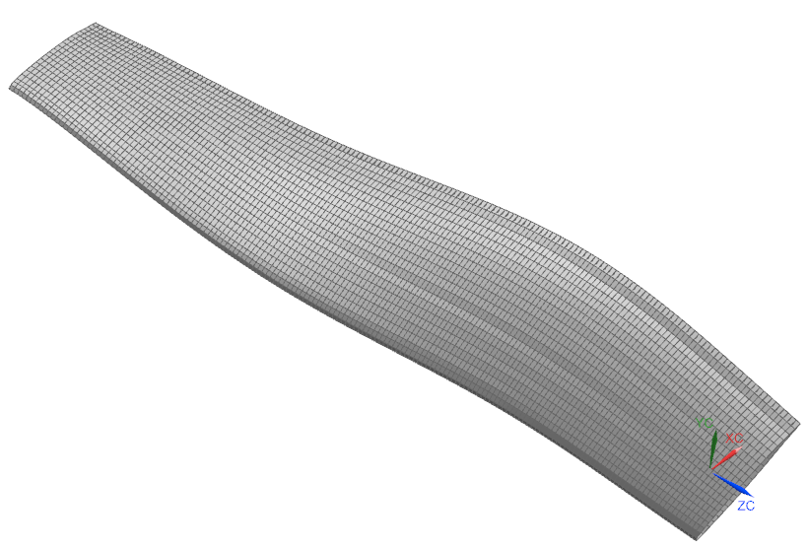
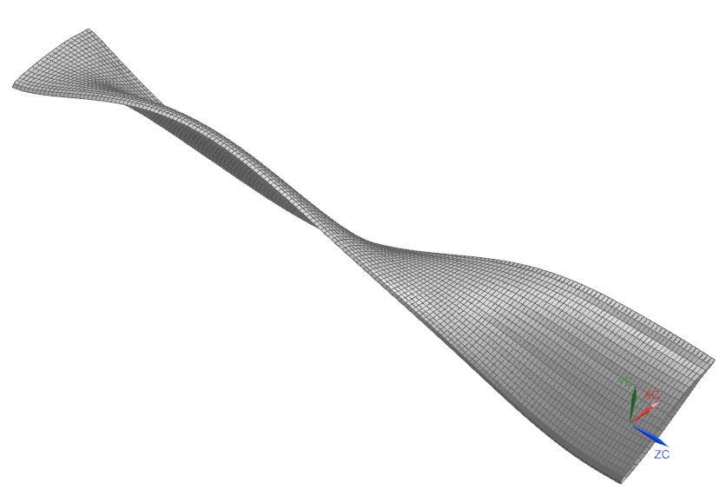
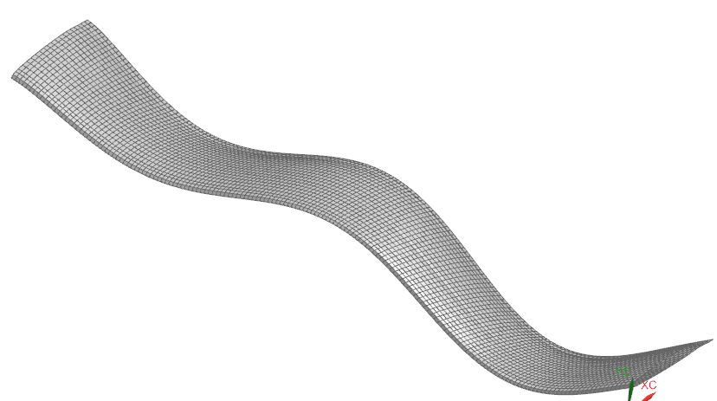
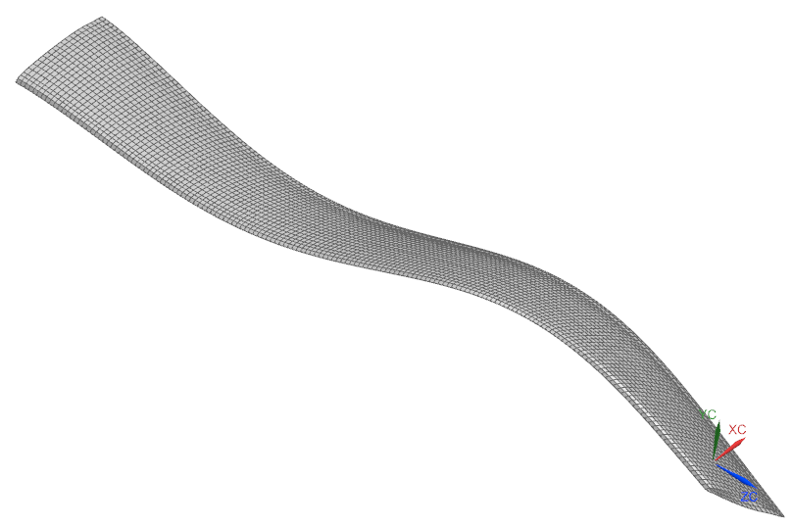
FEA Results (SHELL)
Mode 1
Mode 2
Mode 4
Mode 5
Mode 6
Mode 3

Slide 7
Summary
Simulation results for BEAM and SHELL models matched well with the experimental results.
Max simulation error was 5% for Mode 1 of the SHELL model.
Modal results are re-tabulated below for easier comparison:
BEAM Model
SHELL Model

